Slide 1
ETL Project
BY Xavier de la rosa

Slide 2
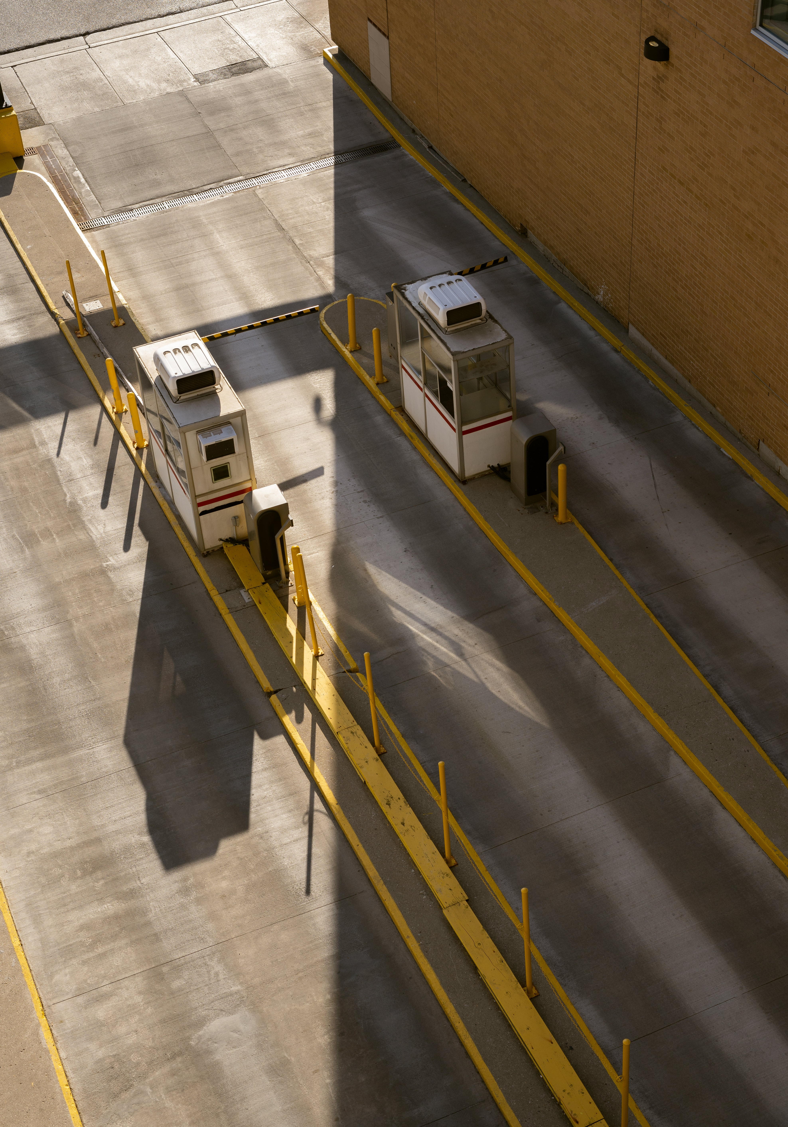

Project Overview
Objective: To extract, transform, and load Los Angeles Parking Citations data and Video Game Sales data.
Background: The city of Angeles hosts the citation dataset that is used in this project on Kaggle.com and is updated daily. Additionally, video games sales data is also found on Kaggle.com.

Slide 3

Extraction (Citation Data)
Size of the data is roughly over 1 GB.
Data ranges from 2010-2019.
The data is given in a CSV format and consists of 19 columns all of which add up to more than 9 million rows of data.
Most of the columns; however, were not usable as they had null values or values for which did correlate with meaningful data.
The columns in this dataset used are as follows:

Slide 4
Extraction (Video Game Sales)
Size of the data is roughly 1.4 MB.
Dataset ranges from 1984-2020.
This data is also given in a CSV format and consists of 11 columns.

Slide 5
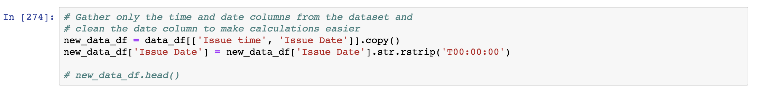
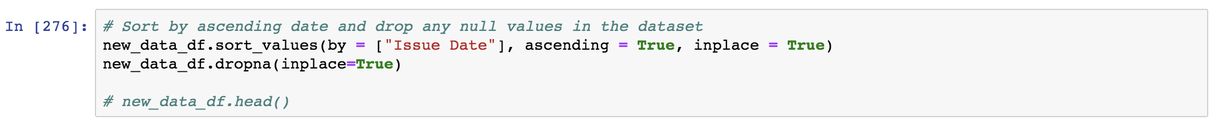
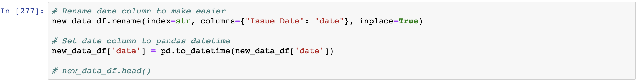
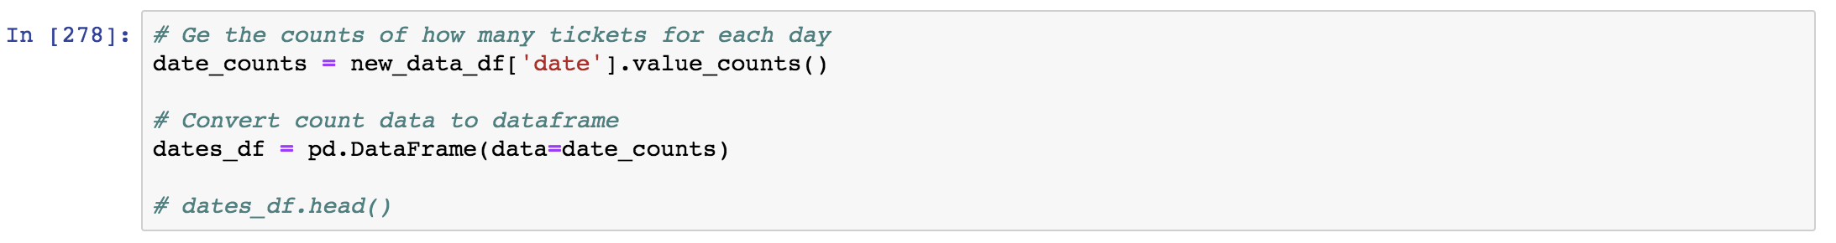
Transformation
The LA citations dataset had to undergo multiple cleaning stages as shown here:

Slide 6

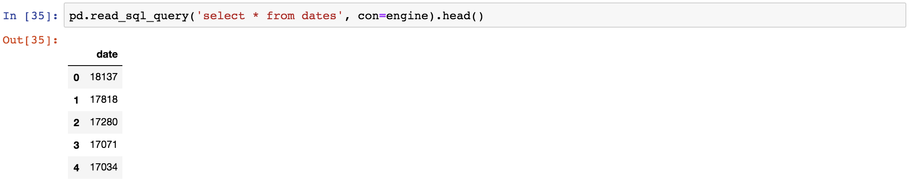
Loading…
The LA citations data and the video game data was loaded from a CSV file to a DataFrame, and finally the data was converted to a SQL database.
MySQL database was chosen for both datasets because the data used is structured and unchanging.

Slide 7
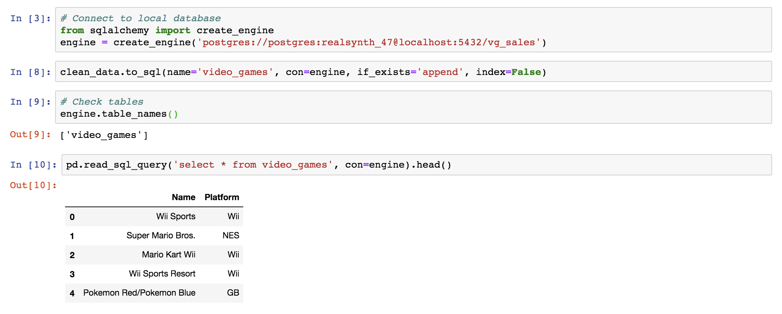
Loading…

Slide 8
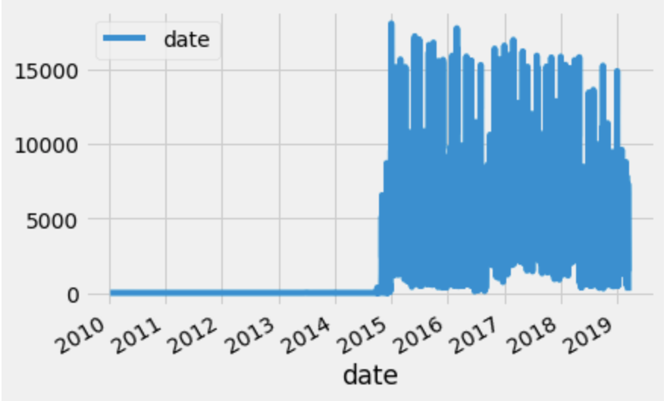
Data Exploration (Citation Data)
How many tickets were there as a total?
9,068,783 unique tickets
How many tickets were there in 2014?
39,443 unique tickets
How many tickets were there in 2015?
2,181,378 unique tickets
Average ticket fine amount: $68.81.
Most popular violations:
NO PARK/STREET CLEAN
METER EXPIRED
RED ZONE
PREFERENTIAL PARKING

Slide 9
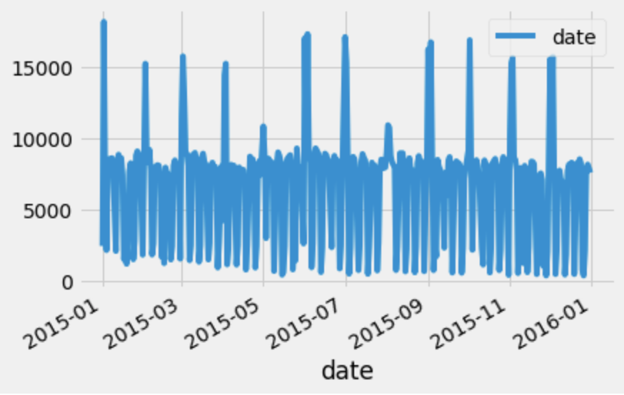
Data Exploration (Citation Data cont.)
Major Findings:
The City of Los Angeles makes roughly $30 million in just three months of parking violations on average.
The worst day to get a parking ticket in LA is the second day of every month.
On average, the best day to avoid getting a parking ticket is the middle of the month.

Slide 10
Summary
Final Findings:
Over the course of this project, there was a substantial increase in parking citations from 2014 to 2015 and beyond. This is due to the fact there were possible profit incentives.
Further, there are patterns for when the most tickets are given out, such as the second of every month, and around noon during the day year-round.
Although this data does show some positive correlations, further analysis is required to extract more abstract and purposeful data visualizations.

